Slide 1
Blazor – Two ways

Slide 2
Agenda
Blazor WASM vs Server
SignalR
Pros and Cons
Making the Choice

Slide 3
Blazor (general)
Blazor lets .NET developers build web apps with C# + HTML + CSS, no need for JavaScript frameworks like React or Angular.
Rich client-side interactivity
  A la JS Frameworks: React, VueJS, Angular
  C# (more transferrable skills for C# developers)
Summary
  Avoid learning JavaScript frameworks
  Stick with C#, stick with Microsoft
Notes:
https://www.pragimtech.com/blog/blazor/what-is-blazor/

Slide 4
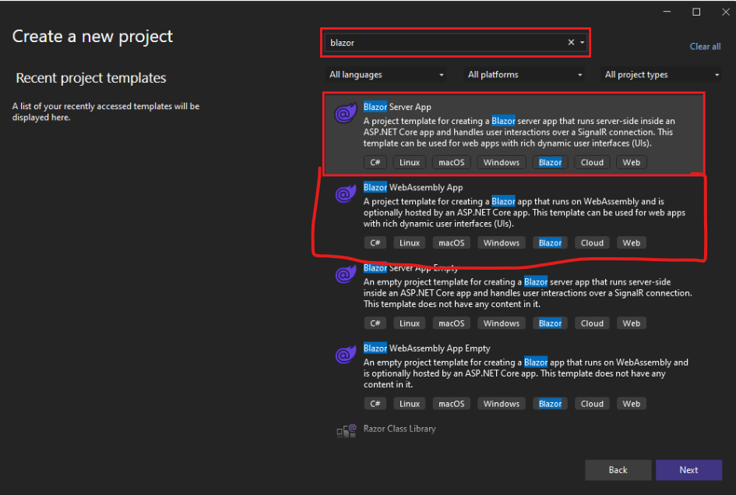
Blazor Server vs Blazor WebAssembly
Two Hosting Models
Model | Where C# code runs | Communication | Works Offline?
Blazor Server | On the server | via SignalR | No
Blazor WebAssembly (WASM) | In the browser | No server required (except APIs) | Yes
Notes:
What are these and what are the key differences?

Slide 5
Blazor Server Model
How it works:
  Your C# code runs on the server.
  The browser displays the UI and communicates with the server through SignalR (a real-time connection).
  Every click, input, or event triggers a message sent to the server.
  The server processes it and sends back UI updates.
Real example scenario:
An internal enterprise dashboard (like a finance app or warehouse control system).
  Requires constant access to secure databases.
  Hosted in one location.
  Always online with stable network.
This suits Blazor Server because it’s secure and doesn’t expose backend code.
Notes:
https://www.pragimtech.com/blog/blazor/what-is-blazor/
CLR = Common Language Runtime – an abstraction of the execution environment that can be used by any of the Microsoft languages (C#, VB, F# C++) on a variety of platforms (Windows, Linux, etc.)

Slide 6
Blazor Server Model
Pros:
  Very small app download (fast load).
  Access to secure resources (e.g., SQL Server, Azure).
  Works on browsers that don’t support WebAssembly (like older IE).
Cons:
  Needs constant network connection.
  Slower if latency is high.
  Doesn’t work offline.
  Scalability: each connected user uses a server session.
Notes:
https://www.pragimtech.com/blog/blazor/what-is-blazor/
CLR = Common Language Runtime – an abstraction of the execution environment that can be used by any of the Microsoft languages (C#, VB, F# C++) on a variety of platforms (Windows, Linux, etc.)

Slide 7
Blazor WebAssembly (WASM)
How it works:
  C# code runs inside the browser thanks to WebAssembly (WASM).
  When you open the app, it downloads:
    the .NET runtime
    assemblies
    JavaScript interop helpers
    CSS and HTML
  After that, it executes locally, like a small app inside your browser.
Real example:
A public-facing product catalog or offline tool.
  Users can browse and filter data even without internet.
  The app fetches an API only when needed.
  Example: a travel booking app, or a classroom attendance tracker used offline.
Notes:
https://www.pragimtech.com/blog/blazor/what-is-blazor/
CLR = Common Language Runtime – an abstraction of the execution environment that can be used by any of the Microsoft languages (C#, VB, F# C++) on a variety of platforms (Windows, Linux, etc.)

Slide 8
Blazor Server Model
Pros:
  Very fast once loaded.
  Can work offline.
  No continuous connection needed.
  Distributable via CDN (static hosting).
Cons:
  Slower initial load (downloads assemblies).
  Limited access to secure resources (needs APIs).
  Debugging tools still improving.
Notes:
https://www.pragimtech.com/blog/blazor/what-is-blazor/
CLR = Common Language Runtime – an abstraction of the execution environment that can be used by any of the Microsoft languages (C#, VB, F# C++) on a variety of platforms (Windows, Linux, etc.)

Slide 9
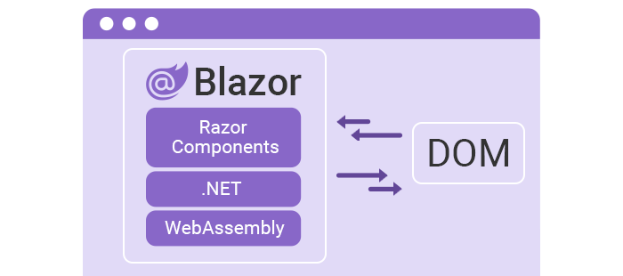
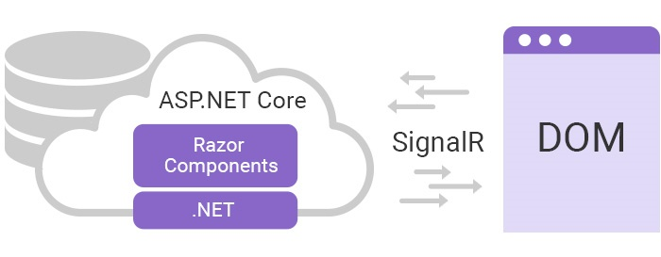
Direct Comparison
Web Assembly
Server

Slide 10
SignalR
SignalR is an integral part of Blazor and offers these features:
  It is free, open-source and part of .NET Core
  Sends async messages over persistent connections
  Connections are two-way
  Every client has its own connection
  Azure SignalR Services offers a free tier
  Think of SignalR like a live chat connection; whenever something changes on the server, it “pushes” updates instantly to the browser.
Example :
  A live car-tracking dashboard (like Uber) : every vehicle position update is sent to all connected clients through SignalR.
  Chat or stock price update apps : use SignalR for instant refresh.

Slide 11
Choice of Hosting Model
 | Blazor Server | Blazor WebAssembly
Complete .NET Core API compatibility | ✔️ | ❌
Direct access to server sources | ✔️ | ❌
Small payload size with fast initial load time | ✔️ | ❌
App code secure and private on the server | ✔️ | ❌
Run apps offline once downloaded | ❌ | ✔️
Static site hosting | ❌ | ✔️
Offloads processing to clients | ❌ | ✔️
Notes:
†Blazor WebAssembly apps can use server-hosted APIs to access functionality that must be kept private and secure.

Slide 12
Recap - Blazor
Not just a single tool, but a framework/toolset with deployability options
  Client vs Server deployments
  Continued investment by Microsoft
  Works on Web standards (WASM, Web sockets, etc.), no special environmental requirements
May make sense if you’re in a strong C# shop
  Corollary – if your in a strong JS shop, then… may not make sense to adopt Blazor
Notes:
https://visualstudiomagazine.com/articles/2021/08/17/silverlighted.aspx

